Slide 1
HSE Centre_Health Regions Update
March 2024

Slide 2
Background and Introduction

Slide 3
Why are we reorganising to six Health Regions?
The Health Regions are an important part of putting Sláintecare in action.
At the moment, our Hospital Groups (HGs) and Community Health Organisations (CHOs) serve populations that are grouped in different ways, covering different areas and services that are managed separately.
This makes it hard for the health system to deliver integrated care. We aim to address this with the creation of the six Health Regions.
The HSE health regions will plan and provide public health and social care services for the people in that region.
The roll out of the Health Regions has commenced on 1st March 2024 and will provide services that are:
Integrated, locally planned and delivered
Easier to access and navigate for patients and their families
Available closer to patients’ home when they need them – right care, right place, right time
Notes:
The new Health Regions will be responsible for delivering both hospital and community care to six clearly defined geographies.

Slide 4
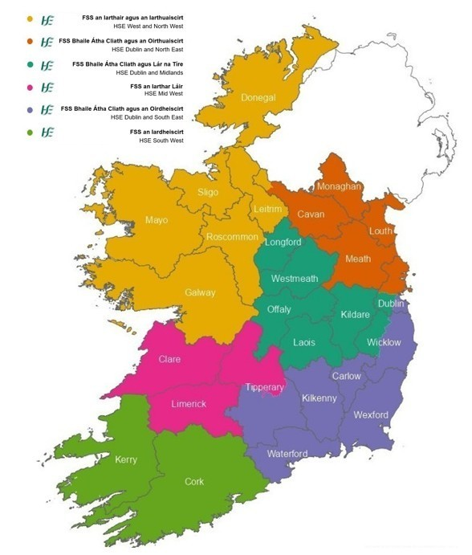
Benefits of Health Regions
The overall vision for our national health and social care system is universal healthcare for all, ensuring the Sláintecare objective of the right care in the right place at the right time for all.
Health Regions will support:
Safe, high-quality, integrated care for all patients. This means one health and social care service designed for the needs of the people and communities in each region.
Aligned hospital and community-based services so that they can work together and deliver more joined-up, co-ordinated care closer to home
People in accessing the same quality of care no matter where they live, and resources are fairly allocated and accounted for
Improved the health and well-being for people in each region
Notes:
The organisation of the HSE along clear regional lines aims to facilitate the delivery of integrated health and social care designed around people and planned around communities.

Slide 5
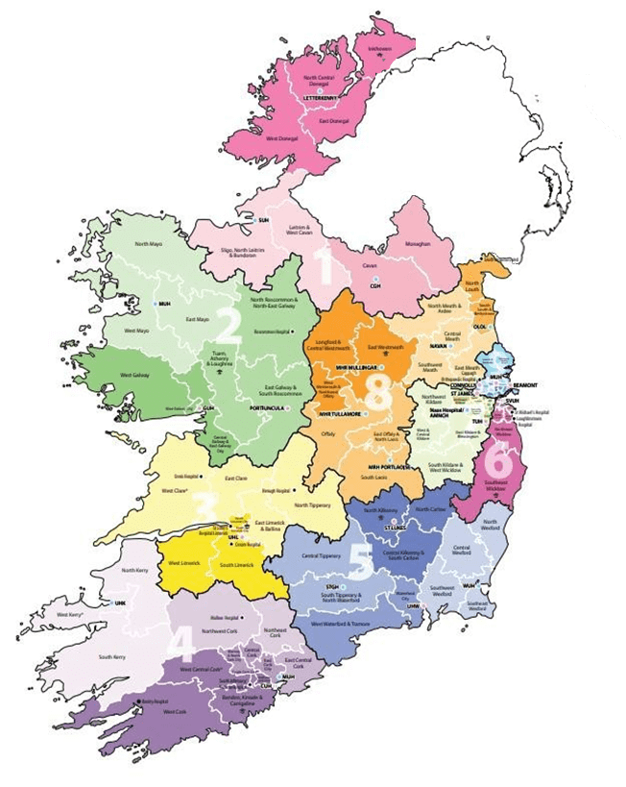
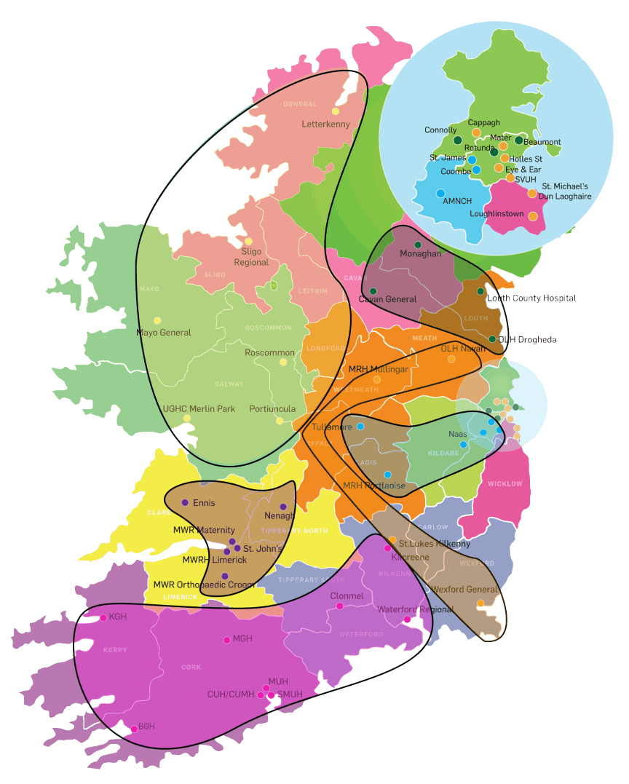
CHOs and HGs to Health Regions
Community Health Organisations
Hospital Groups
Find more information about Health Regions on a new “About the HSE” website: https://about.hse.ie/health-regions/
Notes:
Six Health Regions have been established within the HSE on the basis of the geographical boundaries agreed by the Government in July 2019.
People will be able to find Health Regions landing pages on a new “About the HSE” website: https://about.hse.ie/health-regions/ From there, a user can - find out which areas the health region covers, what the health region does, who the REO is, and how to contact someone - find hospitals, primary care and urgent and emergency services within the health region

Slide 6
Health Regions - Objectives
1. Align and integrate hospital-based and community-based services to deliver joined-up, integrated care closer to home
2. Clarify and strengthen corporate and clinical governance and accountability at all levels
3. Support a population-based approach to service planning and delivery which aims to address health inequalities
4. Improve equitable regional investment and balance national consistency with appropriate local autonomy to maintain consistent quality of care across the country
5. Run an efficient, highly productive, and transparent health and social care service with aligned incentives to provide people with timely access to safe, high-quality, integrated care
Notes:
Each Health Region will plan, resource, and deliver health and social care services based on the needs of the local population. In addition to improving accountability and governance in terms of finance and performance, it will also empower frontline staff and bring decision-making closer to the frontline.

Slide 7
What is integrated care?
Integrated care is where people can access the right care, at the right time, in the right place, with the right team.
Designed first and foremost around the needs of the person, integrated care has the dual aim of improving both system efficiency and service user experience and outcomes
In the Sláintecare Report (May 2017) the Committee on the Future of Healthcare defined integrated care:
“Healthcare delivered at the lowest appropriate level of complexity through a health service that is well organised and managed to enable comprehensive care pathways that patients can easily access and service providers can easily deliver. This is a service in which communication and information support positive decision-making, governance and accountability; where patients’ needs come first in driving safety, quality and the coordination of care.”
Notes:
For integrated care to be effective, all levels of our health and social care system must be integrated, including:
Integration between different parts of our primary and community health and social care services including GPs, Pharmacy and other non HSE partners;
Integration between the totality of community health and social care services, primary health and social care services, and acute hospitals; and
Integration with wider public services organisations in recognition of the wider social determinants and effects of health, e.g. local authorities, TUSLA, educational bodies, An Garda Síochána, local voluntary organisations, transport and housing bodies, and others.

Slide 8
The health regions have commenced operation from March 2024.
The Health Regions Programme is a multi-year journey.
Planning and consultation has been happening for the last 2 years or more.
The 6 health regions have started to operate as the Regional Executive Officers (REOs) have taken up post in March.
There will be multiple phases as we transition to full Health Region Implementation.
There will be supports for staff and managers who are working through the transition.
In the meantime, we will all continue in our roles and continue to provide services within our current structures.

Slide 9
HSE New Structures

Slide 10
Regional Executive Officers and HSE Centre Leadership
The six Regional Executive Officers (REOs) have been appointed.
The introduction of health regions from early March and the ongoing plans for change to the HSE centre will lead to overall improvement in governance and leadership of the health service.
Each REO will be the accountable officer at Health Region level, responsible for the delivery of high-quality, safe, and accessible services for the population of their region.
Operational service delivery will be the responsibility of the Health Regions.
The HSE Centre now has an updated leadership team, whose main role is to support and enable the CEO and the REOs and to fulfil the functions of Planning, Enablement, Performance Management and Assurance (PEPA).
Notes:
Regional Executive Officers (REOs) will be accountable and responsible for regional health and social care services. REOs will report directly to the HSE CEO on the operation and management of the Health Regions. REOs will form part of the core HSE Senior Leadership Team, providing regional input into the development of national policies and standards.

Slide 11
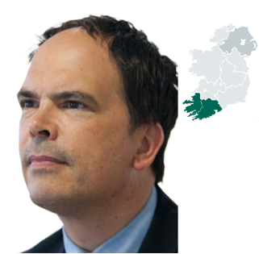
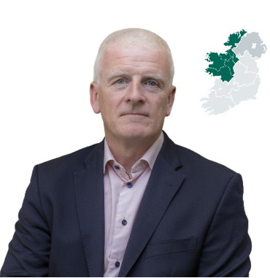
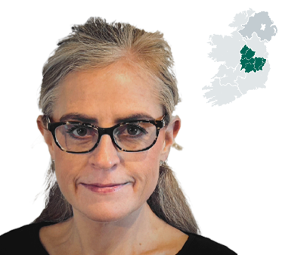
Regional Executive Officers
Sara Long HSE Dublin and North East
Martina Queally HSE Dublin and South East
Kate Killeen White HSE Dublin and Midlands
Dr Andy Phillips
HSE South West
Sandra Broderick
HSE Mid West
Tony Canavan
HSE West and North West
Read detailed biographies for all our REOs on HSE.ie
Notes:
The six Regional Executive Officers (REOs) have been announced. Sandra Broderick took up her post in December 2023, and, Martina Queally commenced in post in January 2024.

Slide 12
HSE Centre New Structure - with appointed National Directors (subject to change following final review)
Patient & Service User Engagement
Performance & Planning
ND – Patrick Lynch
ND - Joe Ryan
HSE CEO
Organisational Culture
HSE CEO
Organisational Change Unit
ND – Liam Woods
Governance & Risk / CRO
Office of the CEO
Corporate Legal Services
National Advisors
Nursing & Midwifery, HSCP, SW
ONMSD, National SW Office incl Safeguarding Unit, HSCP Office
National Services and Schemes
Access and Integration
Clinical
Health Regions x 6
People
Finance
Technology and Transformation
Communications and Public Affairs
Major Capital Infrastructure
Internal Audit
ND
Pat Healy
Interim – David Walsh & Grace Rothwell
CCO
Dr Colm Henry
ND
CPO
Anne Marie Hoey
CFO
Stephen Mulvany
CTTO
Damien McCallion
ND
Mark Brennock
Interim
Brian O’Connell
Chief Internal Auditor Joseph Duggan
NAS
Mental Health, Children, Adults
Clinical Programmes, Pathways
Mental Health
Workforce Planning
Financial Planning & Performance
CIO
External Communications
Major Capital Projects
PCRS / Schemes
Older Persons
Older Persons
NCCP
HR Shared Services
Costing & Pricing
CISO
Internal Communications
National Office
Environmental Health
Primary Care
NWIHP
Primary Care
Leadership & Capability
Finance Specialists
IIS
Complaints / Feedback
Sustainability
NHSS
Disability, Children, Adults
Disability
Population & Public Health
HR Specialist Services
Finance Reform, IFMS
Innovation
HSE Live
Regional Estates
National Emergency Management
Social Inclusion
Social Inclusion
AMRIC
Employee Relations
Finance Shared Services
Technology
Parliamentary Affairs
EU, North /South incl. CAWT
Acute Services
NSS
NISRP
Health Region Finance Support
A2I
Digital Communications
National Appeals Service
Health & Wellbeing, Global Health & Inclusion, Human Rights & Equality, Climate Action
ODTI
Acute Services
Staff Health & Wellbeing
National Procurement
Transformation
Academics & Research
Public Sector Duty
SLA Compliance Unit
CSE
NDTP
E Health
National Patient Safety Office
Data and Information Governance
National Genetics and Genomics Office
Notes:
This image displays the intended structure of the HSE Centre, as of 29.02.24. This is subject to change following final review.

Slide 13
How health services will be organised
One of the most important changes to the HSE is how we will bring services and decision-making closer to the patient and closer to the community as:
Health Regions will plan and deliver health services, with support from the HSE Centre. Each Health Region will have between 2 and 4 Integrated Healthcare Areas
Integrated Healthcare Areas will will bring together both acute and community services under one geographically-based structure for their populations of between 150,000 and 450,000
Community Healthcare Networks will be the building blocks for organising services within each IHA, and there will be approx. 2-8 CHNs and 1-3 Hospitals in each IHA. More information on CHNs available at: https://www.hse.ie/eng/services/list/2/primarycare/community-healthcare-networks/
Health Region
Integrated Healthcare Area (IHA)
Community Services
Acute Hospitals
HSE Centre
Notes:
HSE Centre will focus on functions of Planning, Enablement, Performance, Assurance (PEPA).
Regions are accountable for services planned and delivered to the defined population in their geographies as well as their health outcomes.
Integrated Healthcare Areas will bring together both acute and community services under one geographically based structure.
There are 96 CHNs across Ireland. Each CHN delivers primary healthcare services across a population of 50,000 and consist of between 4-6 primary care teams, with GPs involved in delivering services. Further information about CHNs can be found at https://www.hse.ie/eng/services/list/2/primarycare/community-healthcare-networks/
Most services planned and delivered locally within agreed national frameworks (e.g. chronic disease management, audiology, maternity services).
Highly specialised services delivered nationally (e.g. neurosurgery).

Slide 14
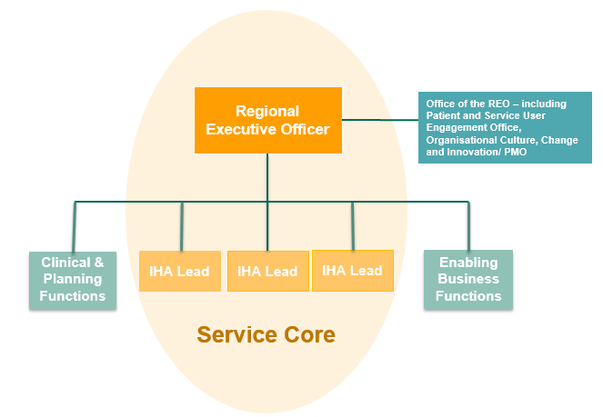
HSE Health Regions Purpose and Function
Health Regions: Purpose & Function
Act as the primary service coordination and delivery units for the vast majority of health and social care services provided across Ireland.
Provide the governance and organisational arrangements to enable planning, management and delivery of care for people and for communities across their region.
Accountable and responsible for regional service delivery in ensuring the best quality health and social care services are delivered to meet both national and local targets and standards of care.
Integrated Healthcare Area (IHA): Purpose & Function
Responsible for the health needs of the whole population within the geographical area
Responsible for access and care coordination of health & social care services for patients and service users
Responsible and accountable for the delivery of safe, high quality, patient-centred health and social care services locally.
Enable and drive integrated service delivery by placing responsibility for the operational management of all hospital and community-based services within the geography under a single team.
The EMT will include IHA Leads (depicted in the diagram above) along with others, including clinical leadership and business supports.
Notes:
The Health Regions EMT will report to the REO.
The EMT will include IHA Leads (depicted in the diagram above) along with others, including clinical leadership and business supports.

Slide 15
Health Regions: Patient / Service User Partnership 1/2
Each Health Region will have a Patient and Service User Council that:
Will be a way for patients and service users and organisations to come together and be partners in healthcare decisions and planning at every level of the organisation
Will assist all teams to deliver an improved service to patients and service users and meet their needs
Will have broad representation across geographic, ethnic, health, age, gender, sexuality and other dimensions
Will actively recruit patient and service user partners to ensure a diverse and inclusive cohort of interested representatives.
Will have a clear set of achievable outcomes which are measurable, collated and analysed nationally to ensure consistency.
Notes:
The Patient and Service User Partnership is an exciting new feature of Health Regions. It provides a structure to enable patient partnership at national, regional and IHA-levels of the organisation.

Slide 16
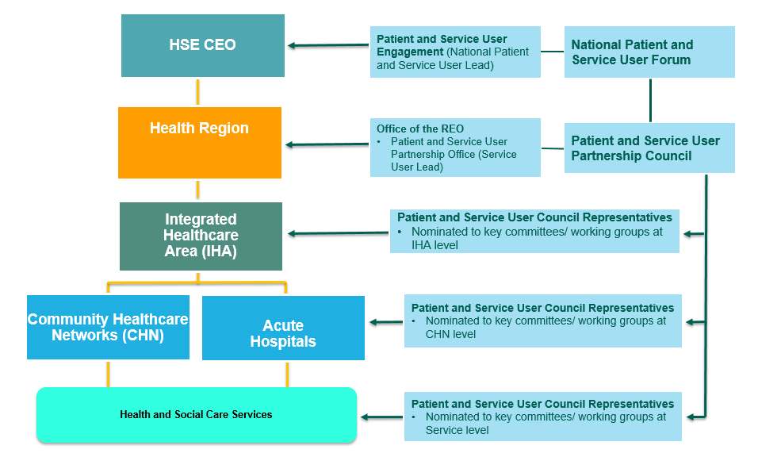
Health Regions: Patient / Service User Partnership 2/2
Notes:
The diagram above demonstrates the proposed Patient and Service User Partnership at all levels of the organisation (national, regional and IHA and local).

Slide 17
High Level Design
Financial Planning
Funding provided to each Region via annual Estimates will be increasingly informed by a population-based resourcing approach (PBRA) (excluding national specialist services).
Regions have appropriate autonomy in deciding how that budget will be spent in line with the services that they are planning for their defined population. This planning will be informed by a Health Needs Assessment (HNA).
Goal is to improve equitable regional investment and balance national consistency with appropriate local autonomy to maintain consistent quality of care across all Regions.
HR & Workforce
Regions will determine local staffing requirements to meet identified local population needs (within agreed national WTE ceilings)
HSE Centre provides frameworks, policies, procedures, protocols, and guidelines (PPPGs) for hiring to ensure consistency.
Notes:
Regional autonomy for financial
Population-Based Resource Approach (PBRA) is a funding model for health and social care planning that seeks to equitably distribute available healthcare resources according to population need to promote allocative efficiency and equity in both health outcomes and distribution of resources planning and staffing are important changes to the HSE that will be core components of Health Regions.

Slide 18
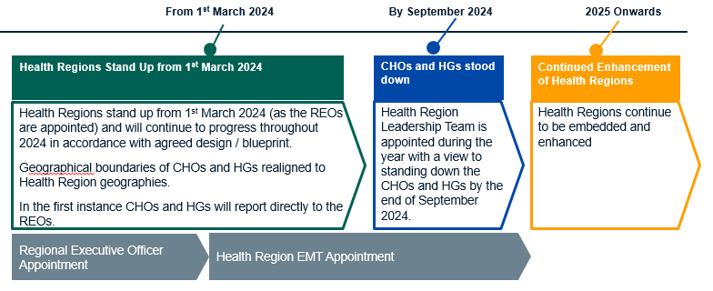
High-Level Implementation Timelines and Expected Phases
As further information becomes available we will share the detail with you. In the meantime it is business as usual as we continue to provide services within our current structures.
Notes:
The Health Regions Programme is a multi-year journey.
It is expected that there will be multiple phases on this journey to full Health Region Implementation.
There is a transition process to be managed and supported.

Slide 19
Implementation Approach and Transition Plan

Slide 20
Next Steps on the Implementation Approach
There will be a transition period from 1 March to 30 September 2024 as each part of the organisation switches to the new Health Region structure, the appropriate delegations and instructions will issue. There will, to some degree, need to be a shadow system during this period. This is to ensure that services are maintained at all times.
The target date for completion of the primary changes in structures and assignments is 30 September 2024.
The first wave of transition will prioritise the fulfilment of senior roles across the Health Regions and Centre, with the focus in Q1 2024 on fulfilment of direct reports of the CEO and direct reports of the REO which will extend to Q3 2024.
The second wave of transition will focus on other roles within the structures. These will be filled on a function-by-function basis from Q2 2024.
National HR with regional colleagues will lead on people transition activities. Engagement with staff representative organisations will be an ongoing feature of the transition process. National HR and regional colleagues will also be responsible for the ongoing provision of guidance to Regions and the Centre during the period of transition.
There will be ongoing staff communications and engagement sharing what is happening now and what will happen next with the new Health Region structure.
Notes:
Description of Transition
HSE Regional Executive Officer (REO) appointed with formal accountability for their area, reporting to the HSE CEO (March 2024)
15 CHO and HG COs / CEOs remain in place reporting to HSE Regional Executive Officers (March 2024 – end September 2024)
CHO and HG boundaries changed to align to future boundaries (March 2024 – end September 2024)
HSE Health Region Executive Management Team appointed to support the HSE REO to stand-up the Integrated Health Areas and support the handover and transition to Health Regions from current structures (from October 2024)

Slide 21
Change Management Supports

Slide 22
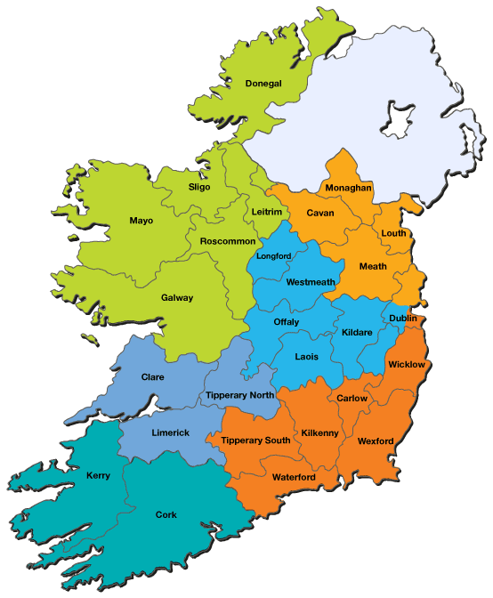
Change Management supports
Compelling need to have dedicated change management supports in place for Health Region implementation - we need the expertise to make the change happen at scale within reach region.
Ensuring ‘line of sight’ from front line service delivery to national will be achieved through the agreed spine of control driving major change locally supporting the:
REOs
EMTs
Integrated Healthcare Area Managers
Community Healthcare / Hospital Network Managers
Front line teams
Improve access and integration from the first point of contact and at all levels in the care journey for individuals, families and local communities.
Bring about the radical organisational culture change required - ways of working, enabling processes and working relationships within the IHAs and CHNs in particular.
Notes:
Change is nothing new to us. For us to really enable Sláintecare and integration to work we must work collaboratively and tap into the expertise and resources locally.

Slide 23
Change and Innovation Support – Health Regions
Partnership working and relationships will be key to integrating efforts and resources across services.
Change & Innovation supports will be available in each Health Region
Aligned and supported by Organisational Change Unit at the Centre
Change Management support focusing on:
Portfolio and Programme Management
Organisation Development & Design
Building Change, Service Design & Innovation Capability
Systems Change Leadership
Strategic Alliances
Enabling Organisational Adaptability
HSE Dublin and North East
HSE Dublin and Midlands
HSE Dublin and South East
HSE Mid West
HSE South West
HSE West and North West
Notes:
Partnership working and utilising the expertise and resources we have are essential. The Change & Innovation Hubs are a mechanism to structure these support services.

Slide 24
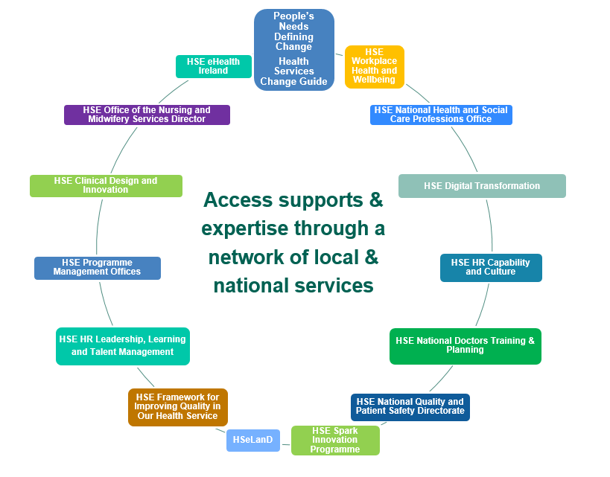
Change and Innovation Support
Notes:
Build your network and connections with key local and national staff with expertise to support your team and wider service during transition.
Many of our services have access to Programme Management support , local quality and improvement expertise and human resources advice.
There is a HR resource desk nationally to support us and you can access by telephone 1800 444 925 each day or by email: ask.hr@hse.ie.
Coaching is also available from hr.nationalcoachingservice@hse.ie
The HSE Employee Assistance Programme (EAP) is a work-based support service for staff and the organisation. This is a confidential independent service. It supports employees with psychosocial issues (psychological and social factors that influence mental health). These issues may be personal or work-related, affecting your job performance or home life.
The service is free and available to all HSE employees.
Call 0818 327 327 to speak to someone who can help.
Also many of our modernised clinical pathways, new business processes and service initiatives have Change Managers allocated to support implementation. These colleagues are there to support you.

Slide 25
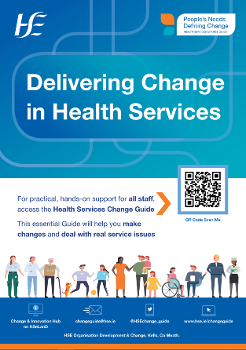
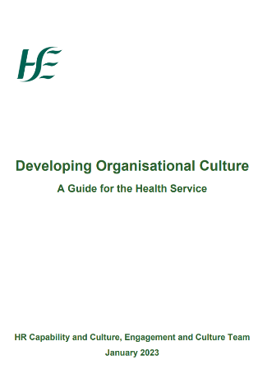
Resources to Deliver Change & Improvement
Notes:
As previously highlighted there are many existing resources and services we can tap into. The services highlighted above offer training, processes and key supports that will help us keep focused on right care, right place, right time by the right person.
Here are links to the above documents
https://www.hse.ie/eng/staff/resources/changeguide/resources/change-guide.pdf
https://assets.hse.ie/media/documents/QPS_Prospectus_2024_web_version.pdf
https://assets.hse.ie/media/documents/Developing_Organisational_Culture_-_Guide_for_the_Health_Service.pdf
https://www.hse.ie/eng/about/who/national-services/partnering-with-patients/resourcesqid/hse-better-together-patient-engagement-roadmap
https://www.gov.ie/en/campaigns/slaintecare-implementation-strategy

Slide 26
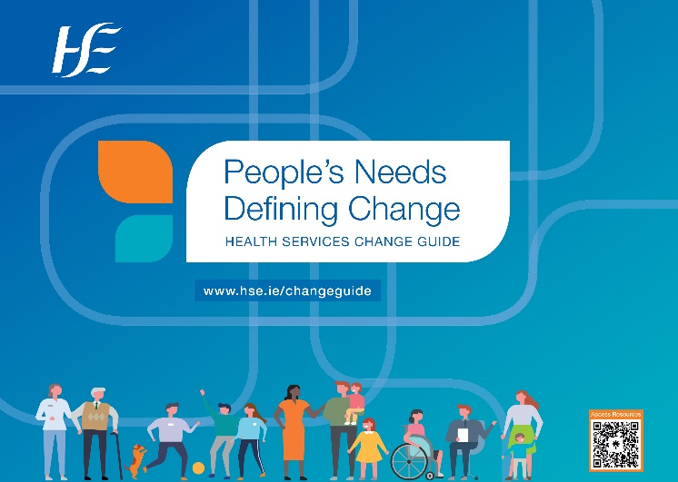
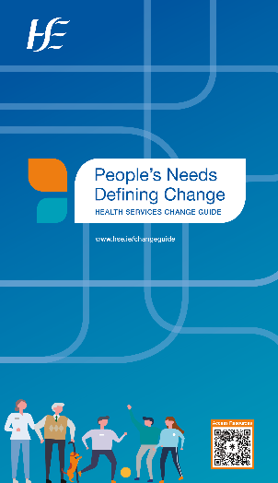
Health Services
Change Guide Resources
Online and in your hands
@HSEchange_guide #Integratedchange
Health Service Change Matters

Slide 27
Contact details for access to
Health Services Change Guide supports:
Scan the code to access HSE Organisation Development
change resources

Slide 28
Further Information

Slide 29
How will I hear more?
More information and support during the transition phase will be available in a number of ways.
HSE Health Regions information web page
https://www.hse.ie/eng/about/who/health-regions/
FAQ document available soon on HSE staff website
If you have a question please contact the
Health Regions team
healthregions.team@hse.ie
Staff & stakeholder engagements
Your line manager and Regional Executive Officer (REO)
Staff email updates, Health Matters and HSE staff website
https://healthservice.hse.ie/staff/
Notes:
You are encouraged to discuss Health Regions at your regular team / department meetings.
As questions arise, you are encouraged to access the resources listed above.

